Slide 1
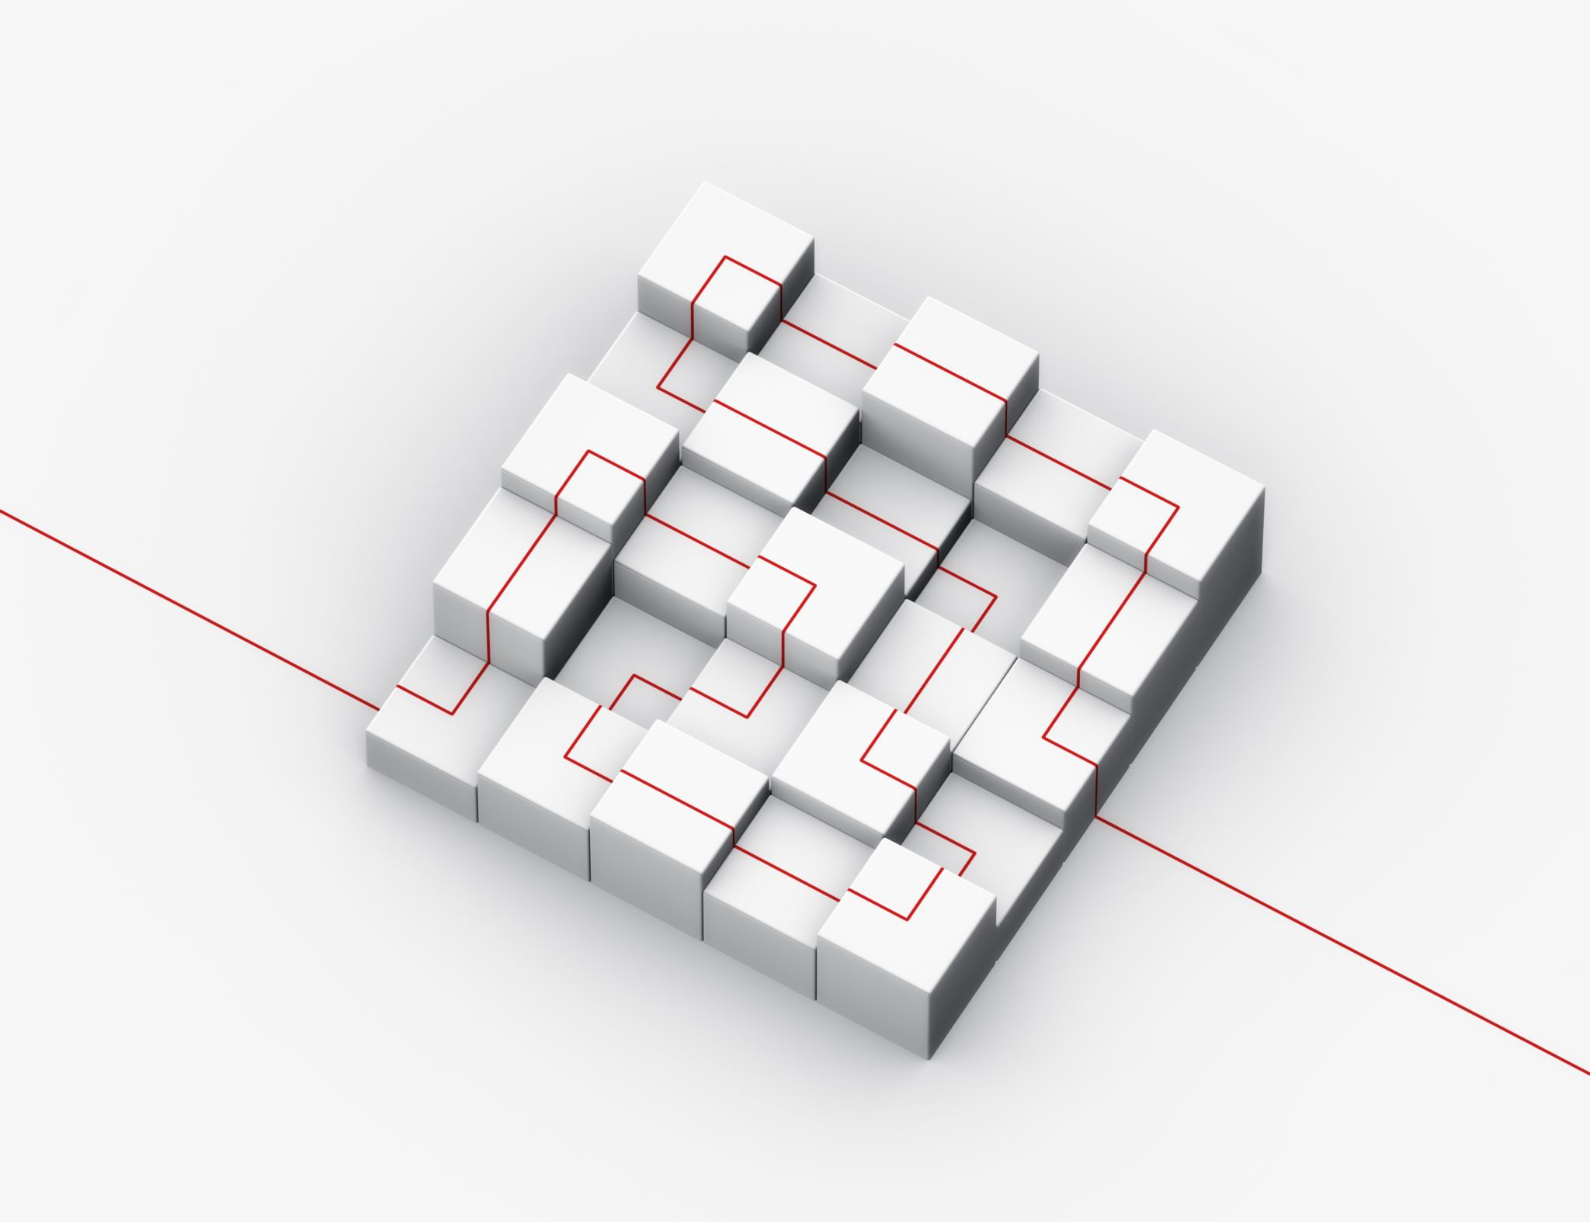

A Survey of Graph Transformers:
Architectures, Theories and Applications
Shilpa Yelkur Ramakrishnaiah - 019151782
Data Mining –CMPE255

Slide 2
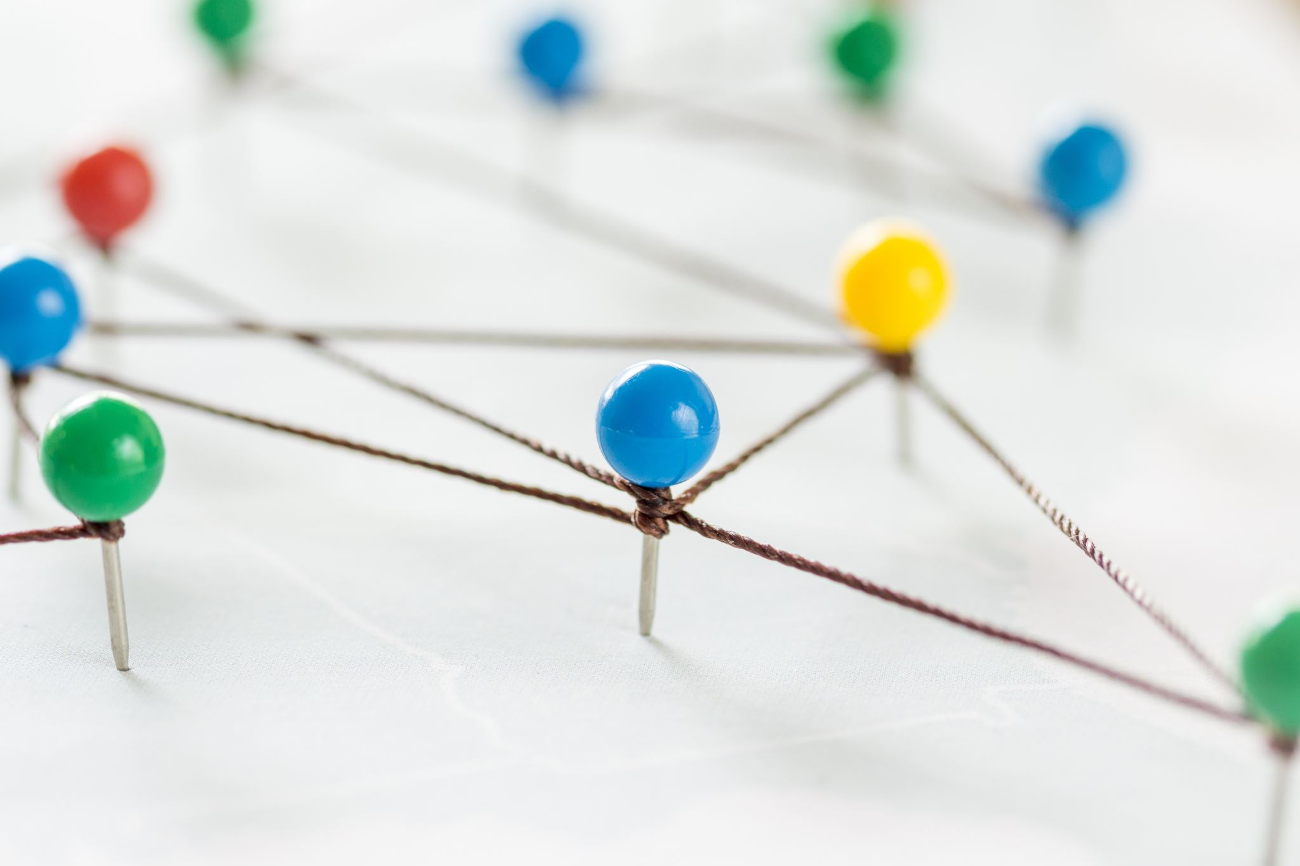
Motivation: Why Graphs?
Graphs model many real-world systems: social networks, molecules, knowledge graphs, traffic, etc.
Nodes represent entities; edges represent relationships or interactions.
We need models that capture both local and global patterns in these graphs.

Slide 3
What Is a Graph Transformer?
Extends Transformer-style self-attention to graph-structured data.
Treats nodes (and sometimes edges or subgraphs) as tokens.
Self-attention enables long-range interactions across the graph.
Incorporates structural information via graph-aware encodings and biases.

Slide 4
Architecture Taxonomy (High-Level)
Structure-enhanced Transformers: inject graph information into standard Transformers.
GNN–Transformer hybrids: combine GNN layers with attention layers.
Hierarchical / subgraph-based Graph Transformers: operate at multiple scales.
Taxonomy helps compare and organize different design choices.

Slide 5
Structure-Enhanced Transformers
Start from a vanilla Transformer architecture.
Add distance-aware or topology-aware biases to attention scores.
Use graph positional encodings (e.g., Laplacian eigenvectors, random walk features).
Relatively easy to integrate into existing Transformer stacks.

Slide 6
GNN–Transformer Hybrids
Combine local message-passing GNN layers with global attention layers.
GNN layers capture detailed neighborhood structure.
Transformer layers capture long-range dependencies and global context.
Often achieve a good trade-off between performance and efficiency.

Slide 7
Hierarchical & Subgraph Graph Transformers
Full attention on all node pairs is expensive for large graphs.
Partition graphs into clusters, patches, or subgraphs.
Apply Transformers at node level and subgraph / cluster level.
Improves scalability and captures multi-scale graph structure.

Slide 8
Theoretical Insights on Graph Transformers
Expressivity: with structural encodings, Graph Transformers can be more expressive than classic GNNs.
Generalization: active research on how GTs generalize across graph distributions.
Complexity: self-attention scales quadratically with number of nodes (O(N²)).
Motivates sparse, low-rank, or hierarchical attention mechanisms.

Slide 9
Applications of Graph Transformers
Molecular modeling and drug discovery (atoms and bonds as graphs).
Recommender systems and e-commerce (user–item interaction graphs, knowledge graphs).
Knowledge graphs and multi-hop reasoning (entities and relations).
Traffic, social, and other real-world networks for prediction and analysis.

Slide 10
Limitations of Classic GNNs
Message-passing GNNs aggregate information only from local neighborhoods.
Over-smoothing: deep GNNs make node representations increasingly similar.
Over-squashing: long-range information is compressed through small neighborhoods.
Difficulty modeling global structure and long-range dependencies.

Slide 11
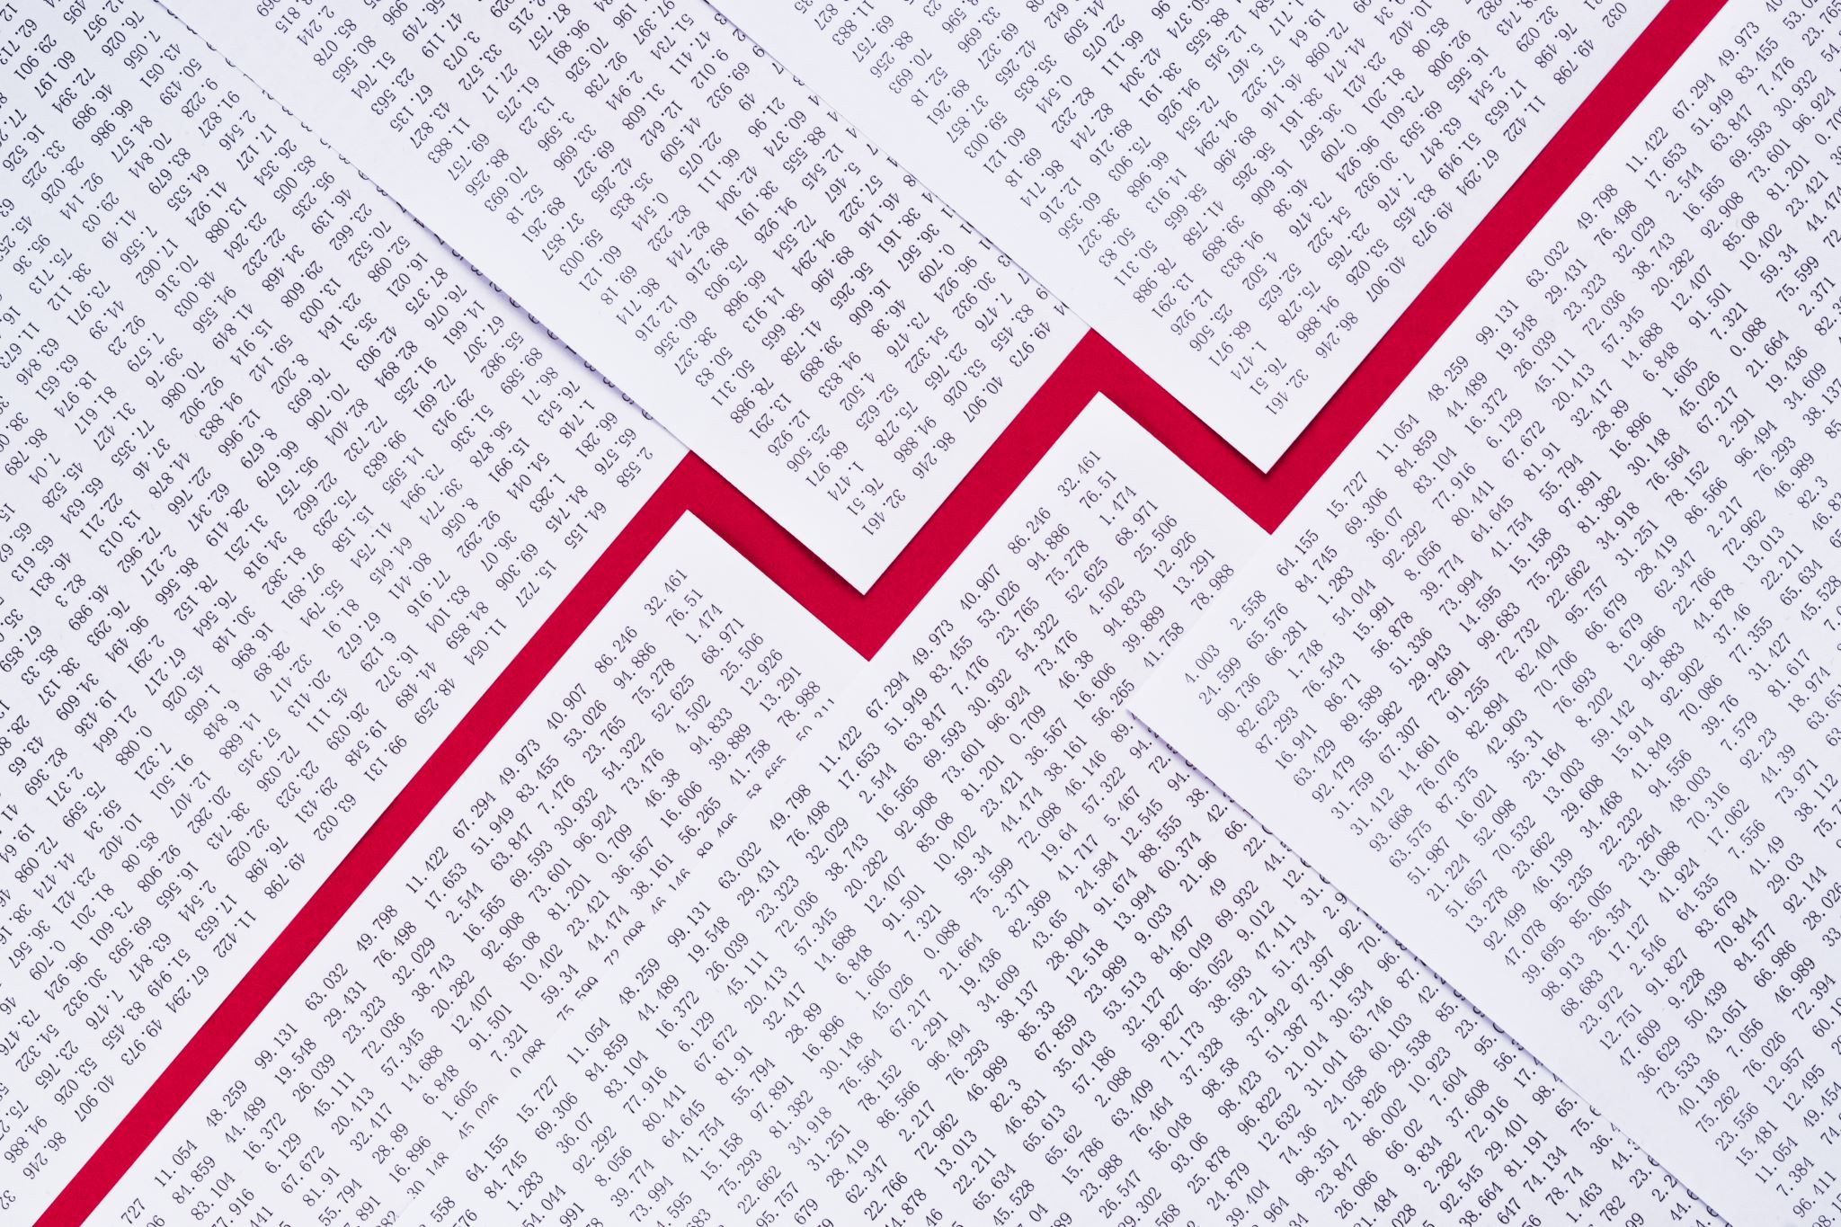
Challenges & Future Directions
Scalability to very large and dynamic graphs.
Improving interpretability of attention and model decisions.
Need for standardized benchmarks and evaluation protocols.
Robustness to noise, missing edges, and distribution shifts.

Slide 12
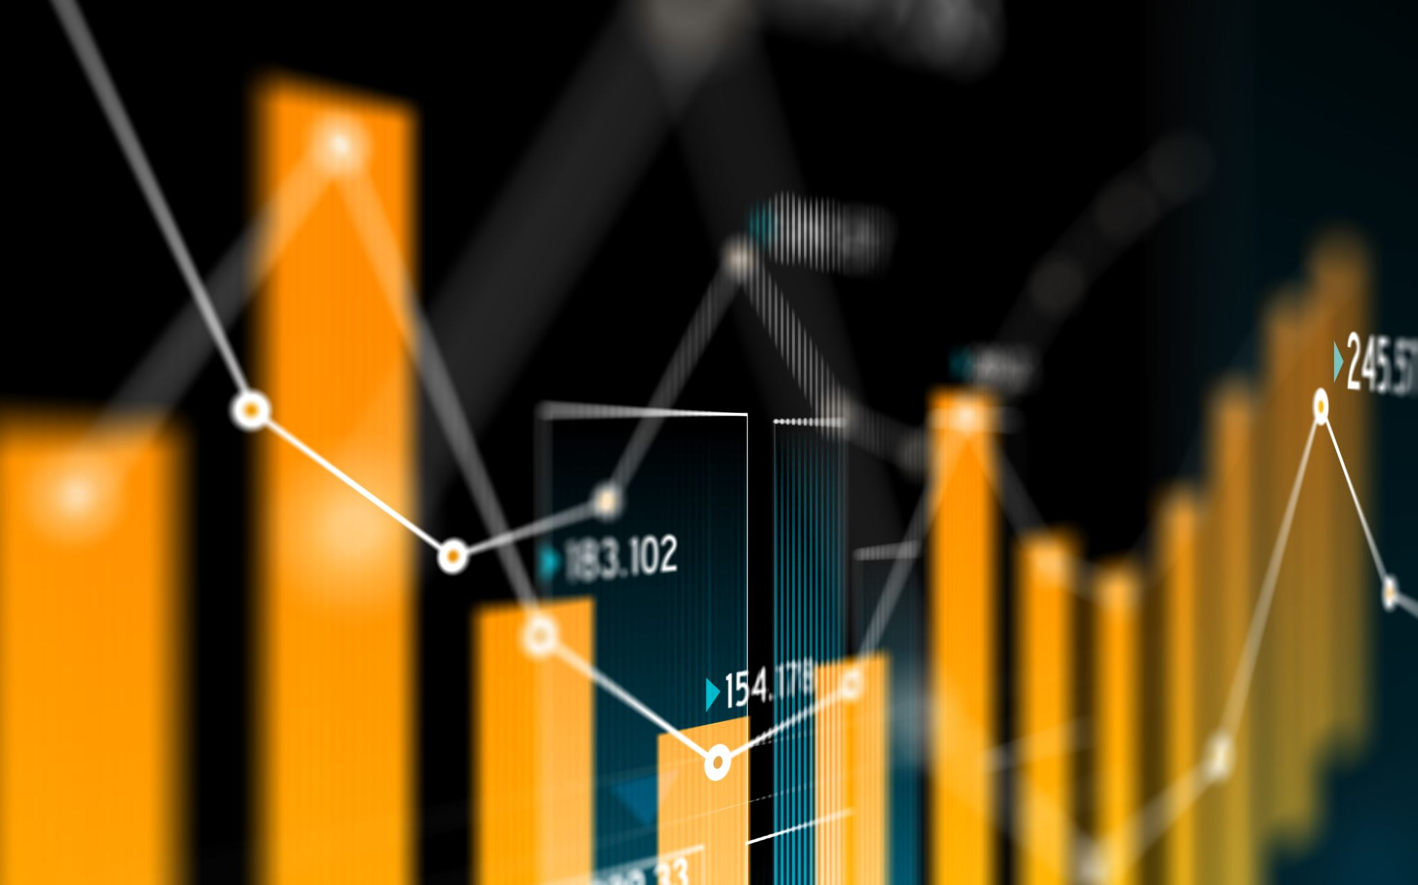
Summary & Takeaways
Graph Transformers merge graph structure with Transformer-style global attention.
Architecture taxonomy: structure-enhanced, hybrid, and hierarchical designs.
Show strong performance across many graph-based applications.
Likely to become core tools in future graph learning systems.
Questions?

